Slide 1


Symmetric & Asymmetric Key
Symmetric and asymmetric keys are two fundamental concepts
in cryptography, and they play different roles in securing digital
information.
Symmetric Key Encryption :
Single Key for Encryption and Decryption: In symmetric key encryption(also known as secret key or private key) the same key is used for both encryption and decryption. This means that the sender and the receiver must both have access to the same secret key.
Asymmetric Key Encryption :
Key Pair (Public and Private): Asymmetric key encryption(also known as two-key encryption) uses a pair of keys—a public key and a private key. The public key is used for encryption, while the private key is used for decryption.
let's take an overview for each key

Slide 2

Symmetric & Asymmetric Key
Symmetric Key Encryption:
Speed and Efficiency: Symmetric key encryption algorithms are typically faster and more efficient than asymmetric key algorithms. This makes them perfectly-suited for encrypting large amounts of data.
Examples: Common symmetric key encryption algorithms include the Advanced Encryption Standard (AES) and Data Encryption Standard (DES).
Use Cases: Symmetric key encryption is often used for secure communications within a closed system or between two parties who share a pre-established secret key. It is also used for encrypting data at rest, such as files on a disk.
Key Distribution Challenge: One of the challenges of symmetric key encryption is securely sharing the secret key between the parties. If the key is compromised during distribution, it can lead to a breach of security.

Slide 3

Symmetric & Asymmetric Key
Asymmetric Key Encryption:
Security and Authentication: Asymmetric encryption is valuable for secure communication and digital signatures. The sender public key can be used by anyone to encrypt messages sent to them, but only the receiver with the corresponding private key can decrypt and read the message. This enables secure and authenticated communication.
Examples: Common asymmetric key encryption algorithms include RSA (Rivest-Shamir-Adleman) and Elliptic Curve Cryptography (ECC).
Use Cases: Asymmetric key encryption is used for secure communication over open networks like the internet. It is also vital for secure email communication, digital signatures, and key exchange protocols.
Key Distribution: The security of asymmetric encryption relies on the privacy of the private key. Public keys can be freely distributed and published, but private keys must be closely guarded. There are also public key infrastructure (PKI) systems that help manage the distribution and verification of public keys.

Slide 4
Diffie-Hellman (key exchange)
What is Diffie-Hellman Key Exchange?
Diffie-Hellman is a method that allows two parties to securely share a secret key over a public (unsecure) channel, without actually sending the secret key itself.
This secret key can then be used for encrypted communication (e.g., using AES).
Is It Secure?
Yes, if:
You use very large prime numbers
You protect against man-in-the-middle (MITM) attacks (e.g., using digital signatures)

Slide 5
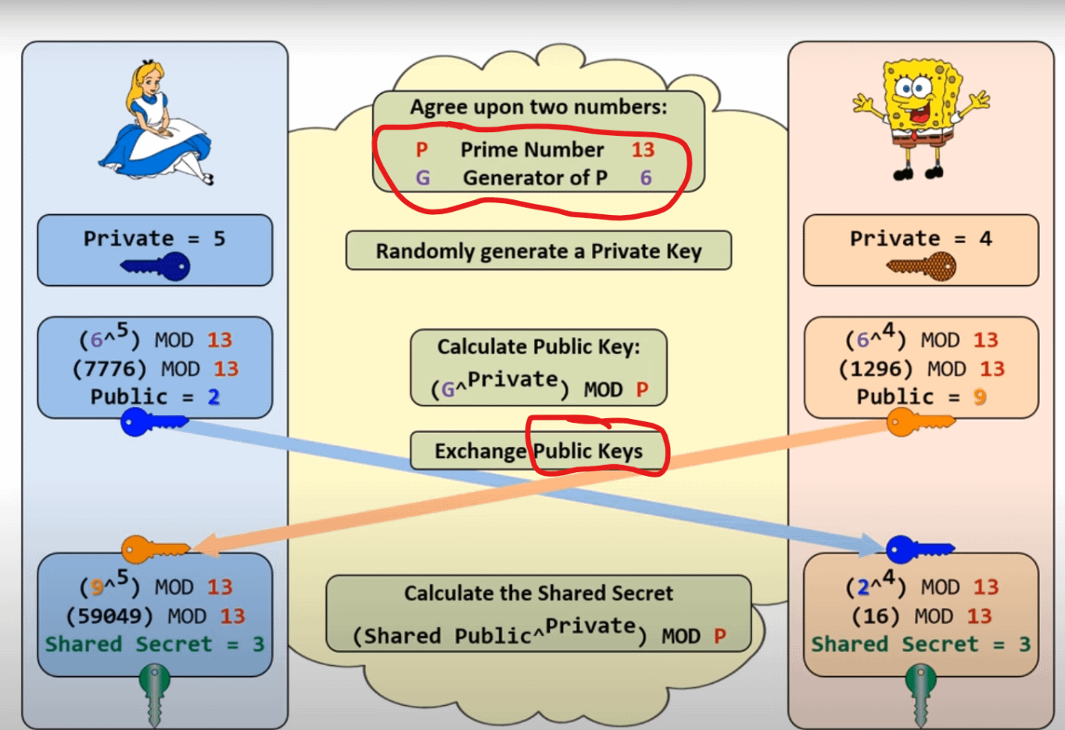

Slide 6
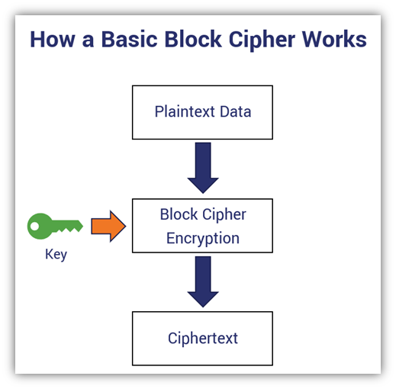
Block Ciphers
A block cipher is a method of encrypting data in blocks to produce ciphertext using a cryptographic key and algorithm.

Slide 7

Block Ciphers
Fixed Block Size: Block ciphers operate on fixed-size blocks of data, typically in multiples of 64 or 128 bits. Common block sizes include 64 bits (as used in the Data Encryption Standard or DES) and 128 bits (as used in the Advanced Encryption Standard or AES).
Symmetric Encryption: Block ciphers use the same secret key for both encryption and decryption.
Key Size: The security of a block cipher depends on the key size. Longer key sizes provide stronger security against brute-force attacks.
Standardized Algorithms: Some well-known block ciphers include DES, AES, Triple DES (3DES), and Blowfish. AES, in particular, is widely used and considered highly secure.
Cryptanalysis: The security of block ciphers is constantly evaluated, and cryptanalysts work to discover vulnerabilities.

Slide 8
Stream Ciphers
A stream cipher is an encryption technique that works byte by byte to transform plain text into code that's unreadable to anyone without the proper key.
Stream ciphers are a type of symmetric-key encryption algorithm used to encrypt and decrypt continuous streams of data.

Slide 9
Stream Ciphers
Bit-by-Bit Encryption: Stream ciphers encrypt data one bit or byte at a time, making them suitable for streaming applications, real-time communication, and hardware implementations.
Security and Key Length: The security of a stream cipher relies on the length. Longer keys are essential for strong security.
Linear Feedback Shift Registers (LFSRs): Many stream ciphers use LFSRs to generate fake random sequences.
Cryptanalysis: Stream ciphers are vulnerable to various attacks, such as ciphertext-only attacks and known-plaintext attacks.
Applications: Stream ciphers are commonly used in wireless communication, secure network protocols (TLS/SSL) (transport layer security/secure sockets layer) , and encryption of real-time multimedia streams.
Examples: Well-known stream ciphers include RC4 (now considered insecure), A5/1 (used in GSM cellular networks), and the more modern stream cipher Salsa20.

Slide 10
Stream Ciphers
Key Generation: Stream ciphers generate a pseudorandom stream of bits(the keystream) based on a secret key. This keystream is combined with the plaintext using a bitwise operation(XOR) to produce the ciphertext.
A5/1 : Shift Registers
A5/1 uses 3 shift registers :
X: 19 bits (X0,X1,X2,…,X18)
Y: 22 bits (Y0,Y1,Y2,…,Y21)
Z: 23 bits (Z0,Z1,Z2,…,Z22)

Slide 11
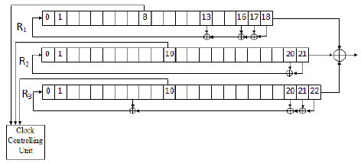
Stream Ciphers
A5/1 : Keystream

Slide 12
Stream Ciphers
Plaintext = 11010010 ciphertext = 11100100
⊕ ⊕
Key = 00110110 plaintext = 11010010
= =
Ciphertext= 11100100 key = 00110110

